Slide 1
WELCOME TO MY PRESENTATION

Slide 2

Submitted By
MST. Tanbin Akter
Roll: 01-031-23
University of Barishal
Submitted To
MD. Mahbub E Noor
University of Barishal

Slide 3
Sales report of XYZ company

Slide 4
Product and Services
Desktop
Laptop
Smartphone
Tablet

Slide 5
➢To find sales, Bonus, Total, Maximum salary, Average salary. I use following condition
•Sales: =SUMIF( E6:E81,”Arif Hossian, “ I16:I81)
•Bonus:=IF(O6>=2000000,O6*10%,IF(O6>=1000000,O6*8%,IF(O6<2000000,O6*8%,IF(O6<1000000,O6*6%))))
•Total: =SUM(N6,P6)
•Maximum Salary : =MAX(Q6:Q11)
•Average: =AVERAGE(Q6:Q11)

Slide 6
Statistics of sales representative
January
Id Name Salary Sales Bonus Total Maximum salary Average salary
1 Arif Hossain 30000 5130000 513000 543000 507833.3333
2 Oishi Das 30000 2390000 239000 269000
3 Parvez Hasan 30000 4710000 471000 501000
4 Nabila Sultana 30000 6930000 693000 723000 723000
5 Eva Karim 30000 4190000 419000 449000
6 Farhan Islam 30000 5320000 532000 562000

Slide 8
Chart and Table
Row Labels | Sum of Total Sales (BDT)
Desktop | 6950000
Laptop | 12250000
Smartphone | 6150000
Tablet | 3320000
Grand Total | 28670000

Slide 9
Sales And Profit comparison between Different Month:
January
8750000
895500
February
9920000
-78300
March
10000000
1014300

Slide 10
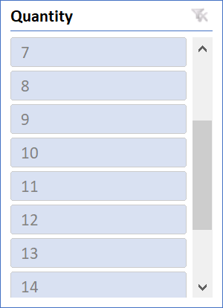
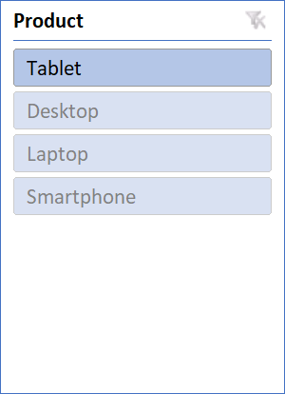
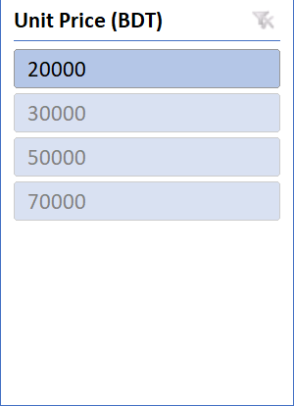
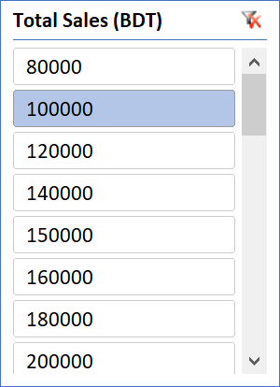
Slicer

Slide 11
Analysis
Sales report of XYZ company
January
Item | Category | Quantity | Unite price | Total
Laptop | Product | 53 | 60000 | 3180000
Desktop | Product | 48 | 45000 | 2160000
Smartphone | Product | 56 | 26000 | 1456000
Tablet | Product | 48 | 17000 | 816000
Office rent | rent expenses |  |  | 12000
Advertisement | Marketing expenses |  |  | 5000
Warehouse rent | rent expenses |  |  | 8000
Internet | Office expenses |  |  | 1500
Staf salary | Operetion expeses | 5 | 30000 | 150000
Administration | Operetion expeses |  |  | 20000
Computer bill | Office expenses |  |  | 2000
Voucher | Marketing expenses |  |  | 3000
Printing materials | Office expenses |  |  | 1000
Additional cost |  |  |  | 40000
Total cost |  |  |  | 7854500
Sales report of XYZ company
February
Item | Category | Quantity | Unite price | Total
Laptop | Product | 55 | 60000 | 3300000
Desktop | Product | 50 | 45000 | 2250000
Smartphone | Product | 79 | 26000 | 2054000
Tablet | Product | 60 | 17000 | 1020000
Office rent | rent expenses |  |  | 12000
Advertisement | Marketing expenses |  |  | 5000
Warehouse rent | rent expenses |  |  | 8000
Internet | Office expenses |  |  | 1500
Staf salary | Operetion expeses | 5 | 30000 | 150000
Administration | Operetion expeses |  |  | 20000
Computer bill | Office expenses |  |  | 2000
Voucher | Marketing expenses |  |  | 3000
Printing materials | Office expenses |  |  | 1000
Additional cost |  |  |  | 1170000
Total cost |  |  |  | 9996500

Slide 12
Thank You

